Slide 1


Too Many Open Work Orders
Project Owner: Rocco Colangelo
Process Owner: Bruce Campbell
Analyst: Tenley Wiltshire

Slide 2

Recognize/Define
  Problem: Current Situation
  An increasing number of Work Orkers are left open in MMS delaying the invoicing of these work orders. Customers Satisfaction is greatly affected as the number of jobs are not being completed.
  Because of the incomplete Work Orders opened for he past six months, revenue for Bombardier is not captured timely.
  Desired Situation:
  Reduce the number of Designated & Unscheduled Repairs open work orders on a monthly basics.

Slide 3
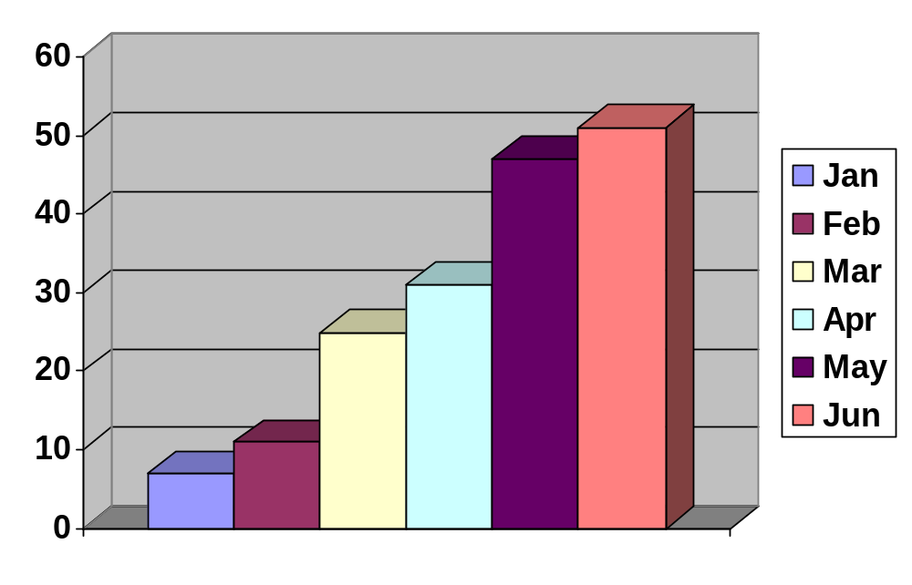
MEASURE PHASE
Quantify the problem
Based on the calculated data on the graph below, the average amount of Designated & Unscheduled Repairs work orders left open for the period of January 2003 to June 2003 was = 28 work orders
Number
of open
W/Orders

Slide 4
MEASURE PHASE continued
Probable Causes
Policy : Not Controlled
Procedure : No maintenance procedure in MMS administration approved ensuring that entries are correct.
Process : No Supervisor follow up to ensure Clerks are using MMS correctly.
Man Power : Same job task, to many work orders opened by different people
Refer To Fishbone Diagram

Slide 5
Critical Characteristics Measurements
Policy
Procedure
Incorrect W/Order entries
-No maintenance procedure in MMS administration approved ensuring entries are correct.
Not Controlled
Duplicate W/Order; opened on one shift and is not mentioned to anyone. No communication
Blank Work Orders Not controlled
No follow up addressed
No Definite Objective
An increasing number of Work orders are left open in MMS delaying the invoicing of these work orders. Customer satisfaction is greatly affected as the number of jobs are not being completed. Because of the incomplete w/orders opened for the past six months, revenue for Bombardier was not captured timely.
Problem
Work orders are generated by Clerks & Supervisors
No Supervisor follow up to ensure Clerks are using MMS correctly
Too many people involved in the process -No Accountability
W/order is not checked by Supervisor to ensure that mechanics comments are added correctly.
Same Job Task: To many Work Orders opened by different people.
Incorrect Job task: training procedure not followed
Work Order opened without reference to Defect Management
Inconsistent Format
- Same job, many w/orders opened by different people
Process
Manpower

Slide 6
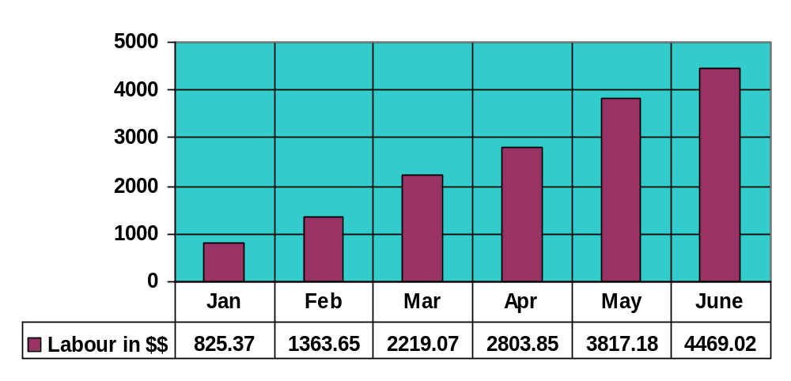
Analyze Phase
Conclusions of the Analyze phase
1. The average monthly revenue not captured by Bombardier was $2,583.02
Please refer to the graph below.

Slide 7
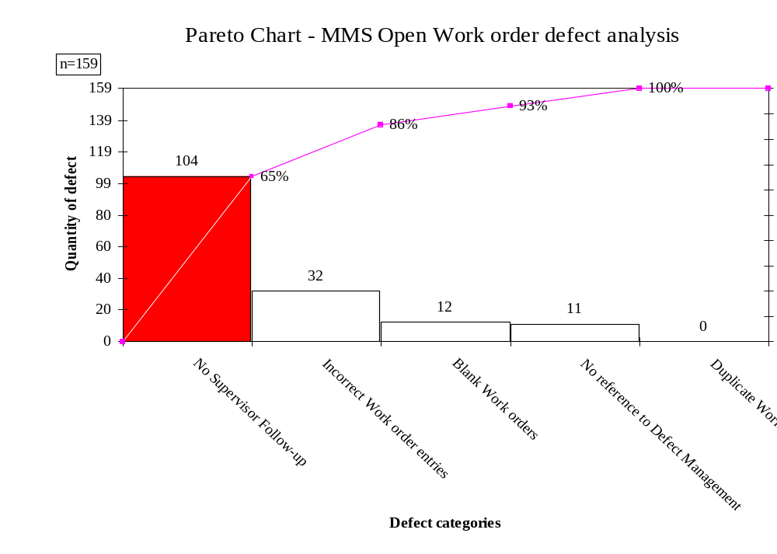
Conclusions of the Analyze phase
2. The highest number of defects found were in the “No Supervisor follow up” category. Please refer to the Pareto Chart below.

Slide 8
Improve Phase
Improvements Implement
1. A Clear defined procedure should be implemented outlining each step taken in the process from when a work order is requested to when a work order is completed.
2. Each Clerk/Supervisor should address all open work orders before the invoice cutoff date.
3. Training should be provided for Supervisors/Managers & Clerks on the newly defined process.
Please refer to figure 1A

Slide 9
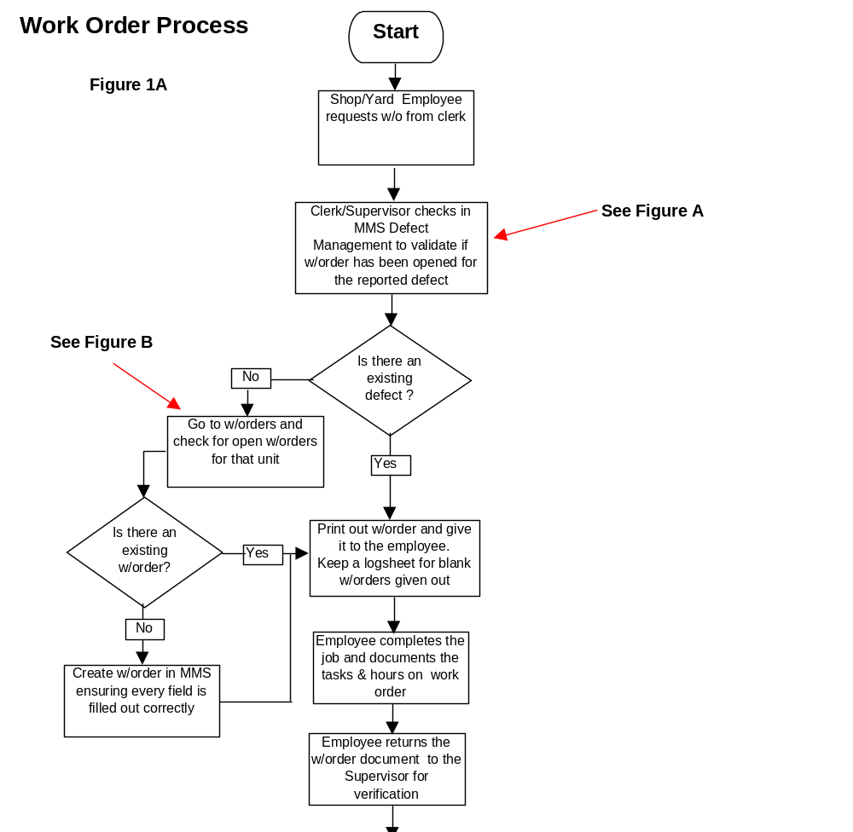

Slide 10
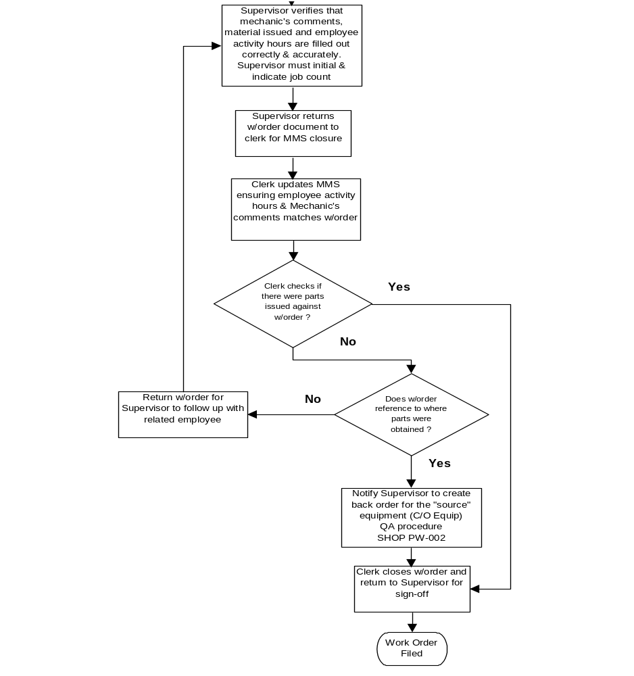

Slide 11
Improve Phase continued
The QA/QC department would perform periodically Audits on closed work orders following the guidelines listed below.
NB: To proper evaluate results, daily audits for a period of seven days would be done initially commencing August 11th to August 15th.
Please refer to figure 1B

Slide 12
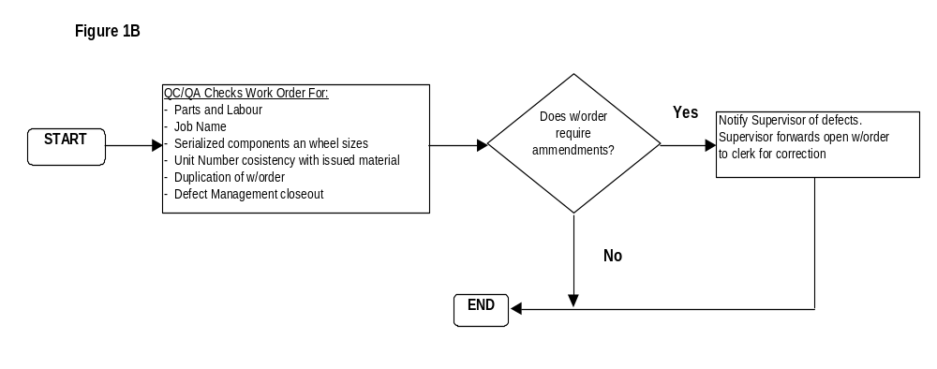

Slide 13
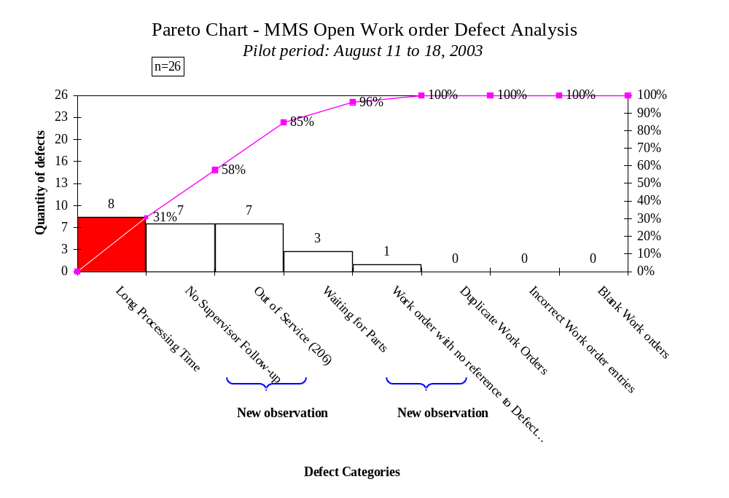
Results Obtained VS. Goals: Please refer to Figure 1C
Figure 1C

Slide 14

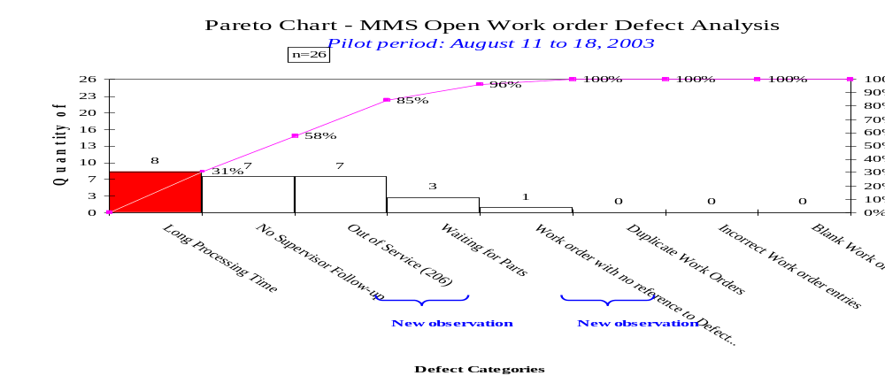
Validation of Implemented
Improvements
With reference to the data recorded before and after the pilot was completed, the improvements implemented were successful.
B
E
F
O
R
E
A
F
T
E
R

Slide 15
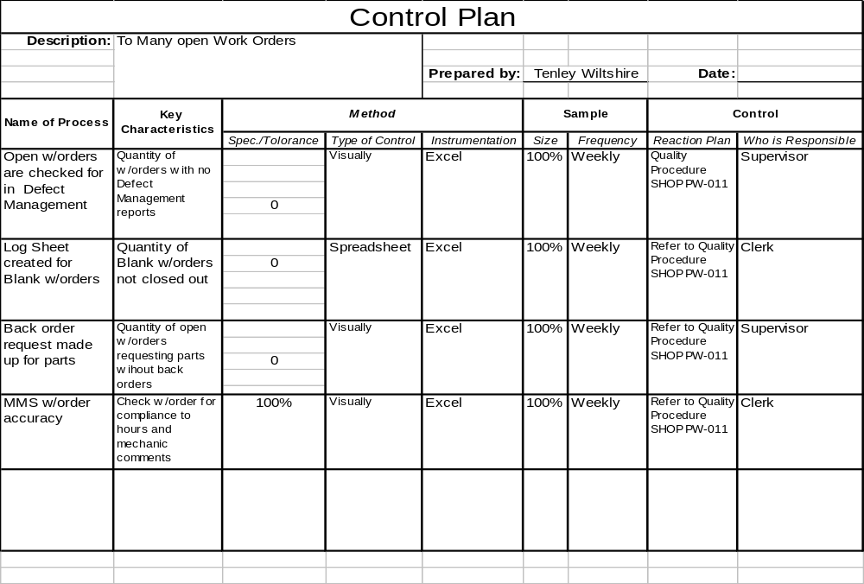
Please refer to QA Procedure SHOP PW-011, Flow Chart (Figure 1A) & Control Plan
Implementation of Control Means.

Slide 16
Six Sigma tools used:
PARETO CHARTS
FISHBONE

Slide 17
Cost, Benefits & anticipated impact
Benefit: $61,992.00 (2yrs)
Calculation is based on Monthly Average Revenue Loss of $2,583.02 as generated from MMS incomplete work orders.
Impact on process metric(s):
1) Training was provided for Clerks on the new process
2) With reference to the data recorded before and after the pilot was completed, the improvements implemented were successful

Slide 18
Standardize & Integrate
Actions to realization to be tracked:
What When Who
No Actions Required
Best practices:
Follow Shop Procedure PW-011
Lessons learned:
If there is no Supervisor follow-up, alot of work orders would remain open.

